Slide 1

Idiom Presentation
By Puxin & Bolun

Slide 2

Janet Zapata

Slide 3
The ball is in your court.
Idioms

Slide 4
Don’t beat around the bush.
Idioms

Slide 5
A penny for your thoughts
Idioms

Slide 6
Black and blue
Idioms

Slide 7
Dead to the world
Idioms

Slide 8
The ball is in your court.
Idioms

Slide 9
The ball is in your court.
Idioms

Slide 10
The ball is in your court.
Idioms

Slide 11
The ball is in your court.
Idioms

Slide 12
The ball is in your court.
Idioms

Slide 13
The ball is in your court.
Idioms

Slide 14
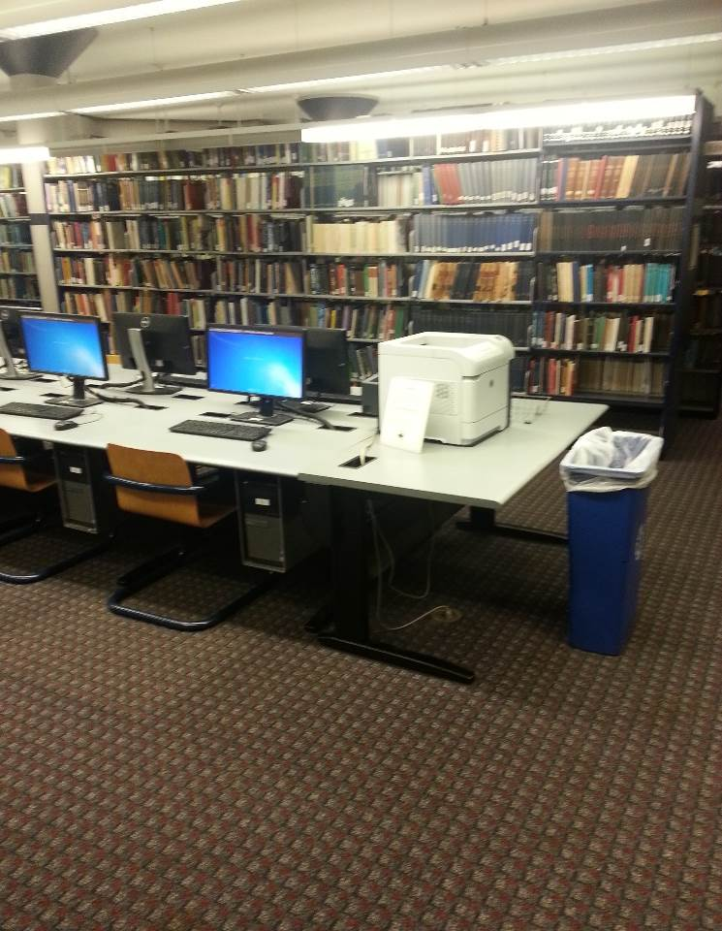
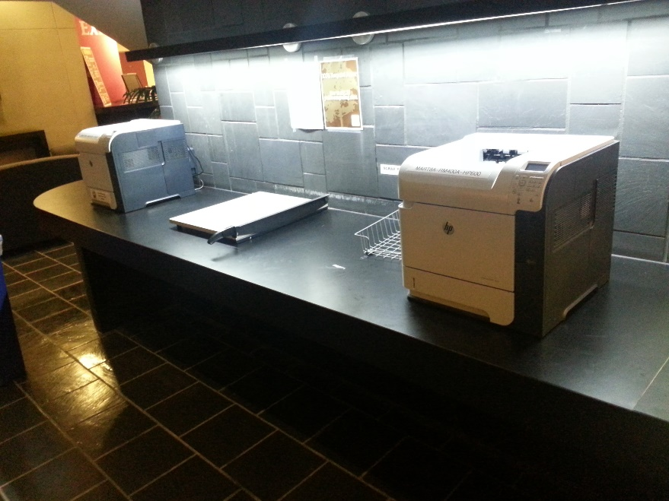
Other Services
Print
On the ground floor, there are several printers.

Slide 15
Thank you !

